Slide 1

Airbnb Madrid Discovery Project
Analysis Report, August 2022

Slide 2

01
Discovery Methodology
System of methods used to reach the project and its conclusions
Table
Of
Contents
02
Project Design
Objectives, Data Entities
Levers and KPIs - Some questions
03
Insights
Data understanding and identification of cause-and-effect relationships and behaviors, with business impact
04
Conclusions
After analysis which general conclusions could be taken and next steps if are required
CONFIDENTIAL
2

Slide 3
01 - Discovery Methodology Framework used in the project
Objective, Growth Levers and KPIs
Entities and Data
Seed Questions
Analysis and Insights
Communication
Business Objective
Growth Levers to afford it
How to measure the growth lever
Which Entities are related
Data available to each entity
First questions to resolve for each initiative
All questions need to be supported by data
Business Analytics Technics to answer the questions
Insights
Clear and Simple
Exhibits Framework
Objective
Data Sources
Big Conclusion
Growth Lever
Data Ingestion
and preparation
Insight Impact
to the business
KPI
Visual
Presentation
Analytics

Slide 4
01
Discovery Methodology
System of methods used to reach the project and its conclusions
Table
Of
Contents
02
Project Design
Levers and KPIs - Some questions
03
Insights
Data understanding and identification of cause-and-effect relationships and behaviors, with business impact
04
Conclusions
After analysis which general conclusions could be taken and next steps if are required
4

Slide 5
02 – Levers and KPIs of the project
Levers
KPIs
After speaking with the valuation team, they tell us that the levers that have the most impact on the profitability of this type of investment are:
Rental price: the more you can charge per night, the higher the profitability
Occupation: in general, the more days a year a property can be rented, the greater its profitability
Real estate price: the cheaper the property can be acquired, the greater the profitability
We will measure occupancy as the number of days per year that the property can be rented
We will measure the rental price as the price per night in euros according to Airbnb
We will measure the price of a property as the multiplication between the number of square meters and the average price per m2 in your area, and we will apply a 25% discount on the official price due to the negotiation strength of our purchasing team.

Slide 6
02 – Some Questions to be analyzed
Questions
About the rental price:
What is the average price? And the price range? And by districts? And by neighborhoods?
What is the ranking of districts and neighborhoods by average rental price?
What factors (apart from location) determine the rental price?
What is the relationship between the size of the property and the price for which it can be rented?
How does the competition (number of properties available per neighborhood) influence the rental price?
How do the prices vary by rental type (entire flat, private room, shared room)?
About the occupation:
What is the average occupancy? And by districts? And by neighborhoods?
How likely is each occupancy level in each district?
What is the ranking of districts and neighborhoods by occupation?
What factors (aside from location) determine occupancy?
What is the relationship between the size of the property and its degree of occupancy?
How does competition (number of properties available per neighborhood) influence occupancy?
About the purchase price:
What is the price ranking per m2 by district?
What is the property price ranking (m2 * average size) by district?
What is the relationship between the price of the property and the rental price by district?
What is the relationship between the price of the property and the occupation by district?

Slide 7
01
Discovery Methodology
System of methods used to reach the project and its conclusions
Table
Of
Contents
02
Project Design
Objectives, Data Entities
Levers and KPIs - Some questions
03
Insights
Data understanding and identification of cause-and-effect relationships and behaviors, with business impact
04
Conclusions
After analysis which general conclusions could be taken and next steps if are required
CONFIDENTIAL
7

Slide 8
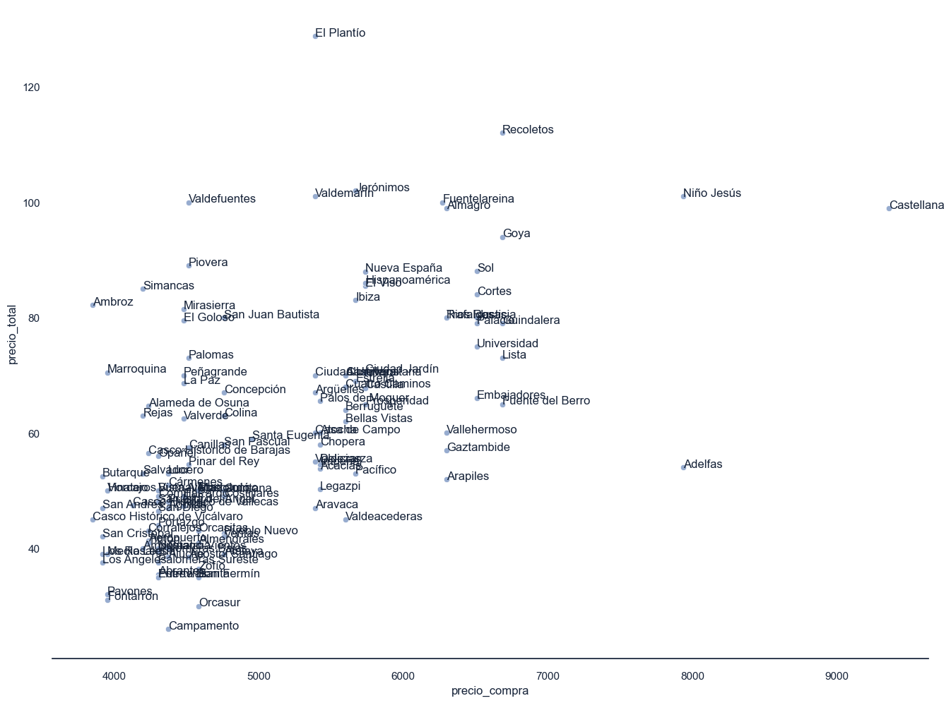
03 – 10 Neighborhoods with great potential investment
Total price vs Sell price
Ratio indicated in €
Conclusions
10 neighborhoods have been located that a priori can maximize the cost-income ratio
We can also segment them by the type of quality of the property in which we are interested in investing in 4 large groups
Low investment: Simancas, Ambroz, Marroquina, San Juan Bautista
Average investment: El Plantio, Valdemarín, Valdefuentes
Medium-high investment: Jerónimos, Fuentela Reina
High investment: Recoletos

Slide 9
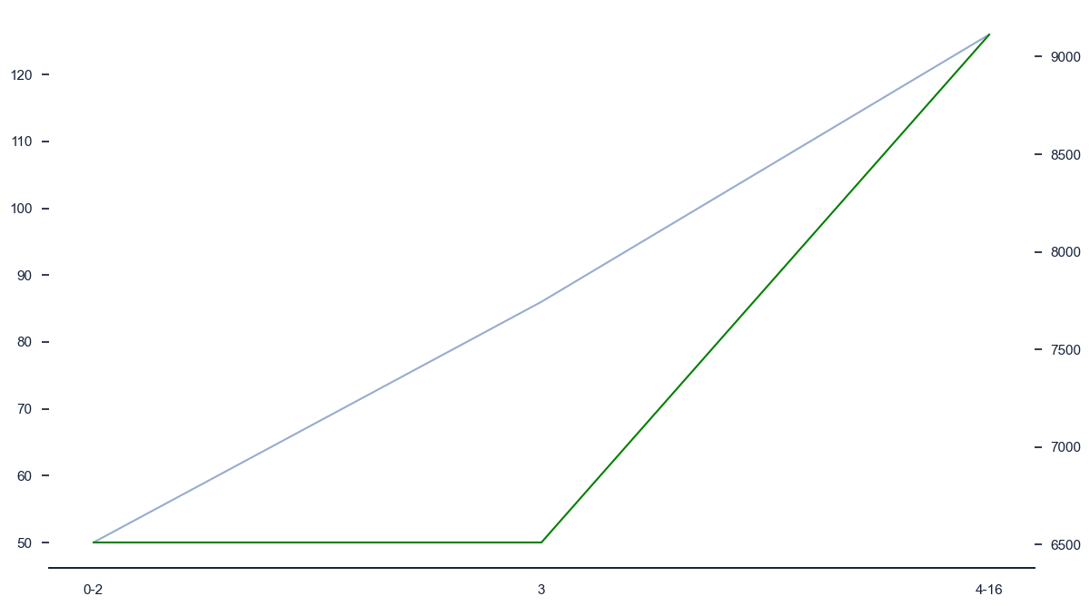
03 - Find one-bedroom properties that allow 3 guests
Accommodates vs total price and sell price
Numbers of accommodates, and €
Conclusions
The number of guests that maximizes the purchase price paid is 3

Slide 10
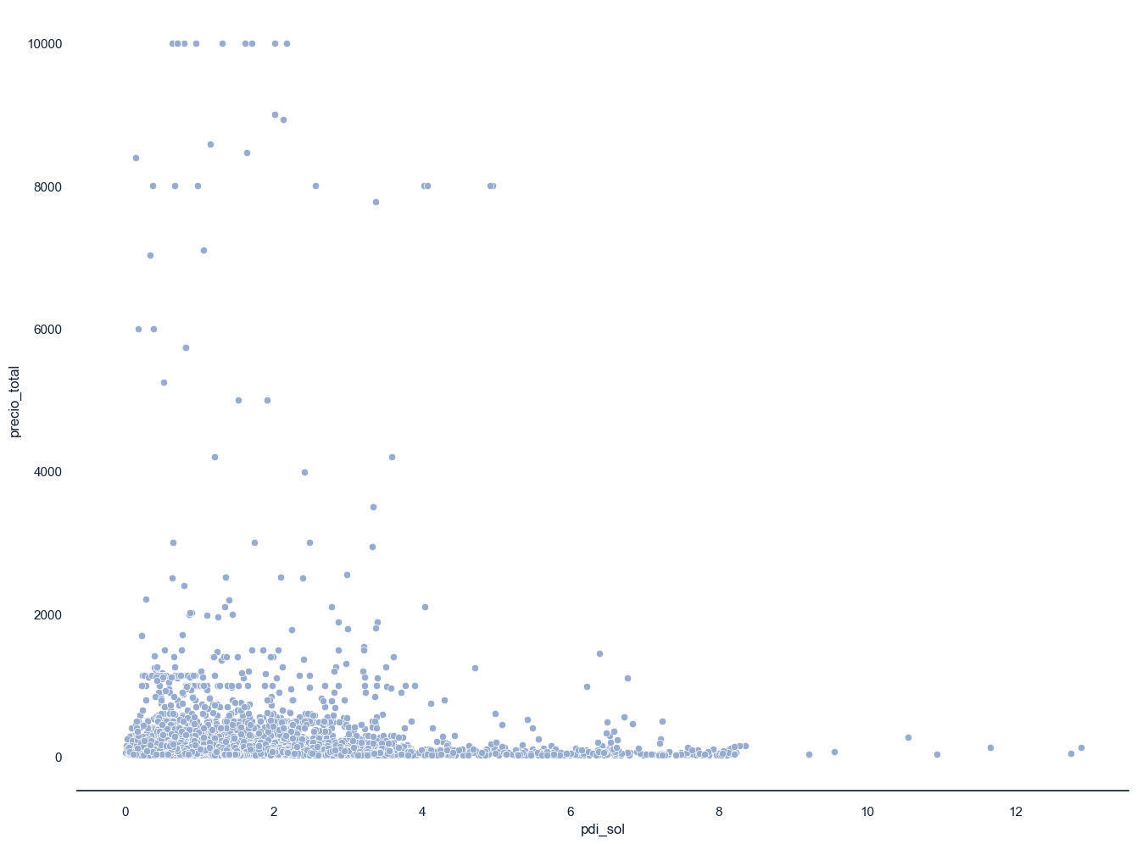
03 - Search for properties that, being in one of the identified neighborhoods, are not necessarily close to points of interest
Distance to Point of Interests (PDI) vs Total Price
Distance in km and €
Conclusions
Predictably they will have a lower purchase price
It seems that the proximity to points of interest does not have a special impact on the rental price

Slide 11
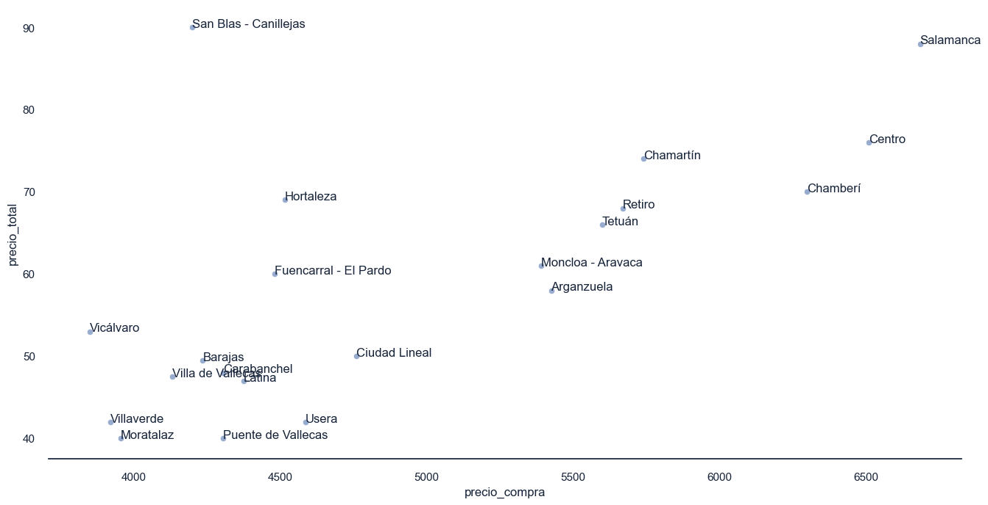
03 - Evaluate the development of a new product based on rental for specific moments of high sporting interest
Ratio Total Price vs Sell Price when special interest moment
Ratio indicated in €
Conclusions
Find opportunities in the San Blas neighborhood
There are still many rentals that are not exploiting this potential

Slide 12
01
Discovery Methodology
System of methods used to reach the project and its conclusions
Table
Of
Contents
02
Project Design
Objectives, Data Entities
Levers and KPIs - Some questions
03
Insights
Data understanding and identification of cause-and-effect relationships and behaviors, with business impact
04
Conclusions
After analysis which general conclusions could be taken and next steps if are required
CONFIDENTIAL
12

Slide 13
04 – After the analysis it’s recommended an action plan of 4 different steps
Insight 1
Insight 2
Insight 3
Insight 4
ACTION #1
10 neighborhoods have been located on which to focus the search
ACTION #2
is recommended to look for properties with a room that can accommodate 3 guests
ACTION #3
It is recommended to search for properties that, being in one of the identified neighborhoods, are not necessarily close to points of interest
ACTION #4
It is recommended to evaluate the development of a new product based on rental for specific moments of high sporting interest, especially in the San Blas neighborhood.

